Slide 1
Chocolate Sales Performance Analysis
Insights & Recommendations for Business Growth

Slide 2
Executive Summary
Goal: Analyze sales data to identify top revenue drivers and optimization opportunities.
Key Finding: The product portfolio is robust, with "Smooth Sliky Salty" leading as the #1 revenue generator (~$1.1M).
Pareto Insight: Revenue is well-distributed; unlike a strict 80/20 split, we have a broad range of high-performing products (top 13 products contribute ~50% of revenue).
Action: Inventory should prioritize the top 5 "A-List" products to prevent stockouts.

Slide 3
Data Methodology
Dataset: Chocolate Sales (2).csv
Data Cleaning Performed:
Removed currency symbols ($) and commas from the Amount column.
Converted sales figures to numeric format for calculation.
Parsed dates to analyze monthly trends.
Key Metrics Analyzed: Total Revenue, Sales by Product, Cumulative Percentage (Pareto), and Geographic spread.

Slide 4
These three products alone generate over $3.2 Million in revenue.
Smooth Sliky Salty
Revenue: ~$1.12 Million
Share: ~5.6% of total sales alone.
50% Dark Bites
Revenue: ~$1.08 Million
Share: Strong second performer.
White Choc
Revenue: ~$1.05 Million
Insight: White chocolate is a surprisingly strong contender, outperforming many dark varieties.
Top 3 "Cash Cow" Products

Slide 5
The Insight: We analyzed which products contribute to the first 50% of our total revenue.
The List:
Smooth Sliky Salty
50% Dark Bites
White Choc
Peanut Butter Cubes
Eclairs
99% Dark & Pure
85% Dark Bars
Takeaway: These 7-10 products are the core of the business. Losing stock on any of these will significantly impact the bottom line.
The "Vital Few"
( Pareto Analysis)

Slide 6
Dark Chocolate: Strong presence with multiple entries in the top tier (50% Dark, 99% Dark, 85% Dark).
Strategy: Continue to market "Dark" varieties as a premium healthy option.
Specialty Flavors: Peanut Butter Cubes and Mint Chip Choco are performing well.
Strategy: These specific flavors have high loyalty; avoid changing their recipes.
Standard Bars: Simple bars (like Eclairs) remain steady sellers.
Product Category Performance

Slide 7
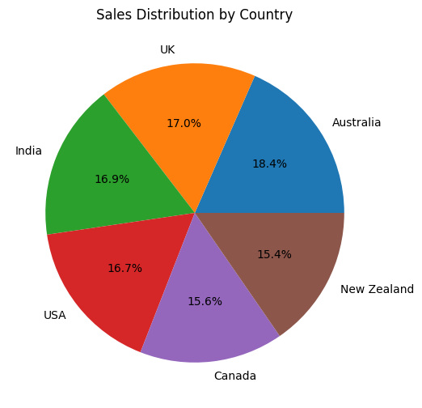
Geographic & Regional Opportunities
Top Region: Australia
Expansion Target: UK and India shows high demand but lower volume.
Recommendation: Increase marketing spend in the #2 region to capture untapped market share.

Slide 8
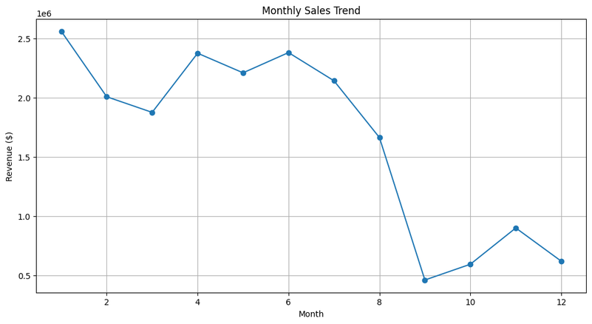
Peak Months: Around January.
Low Season: Around September.
Strategy:
High Season: Ensure 100% stock availability for "Smooth Sliky Salty" and "Dark Bites".
Low Season: Run promotions on lower-performing items to clear inventory.
Seasonality & Timing

Slide 9
Protect the Core: Ensure Smooth Sliky Salty and 50% Dark Bites never go out of stock. They are the business anchors.
Rationalize Inventory: Review the bottom 20% of products. If they have high storage costs and low sales, consider discontinuing them to free up cash.
Pricing Review: Check the "Price Per Box" for White Choc. Since it sells in high volume, a small price increase (e.g., $0.50/box) could add significant pure profit without hurting demand.
Final Recommendations

